Slide 1
Exporting Tables from R
Alex Thomson
10th June 2020

Slide 2
Contents
Introduction
The issue?
The solution?
Packages and appearance of output
Flextable
Kable
gt
Ease of Use
As R users
For teaching
Increased complexity of tables & Special features
Rmarkdown

Slide 3
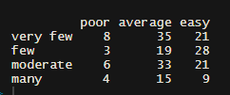
Introduction
The issue?
We conduct our analysis in R but will need to produce our reports within word or create pdfs.
We can save any graphs as an images but what about tables?
Base table function cannot exactly be exported easily from R.
The output in the console is not exactly pretty.

Slide 4

Introduction
The solution?
Common step has been to use rmarkdown
Allows us to create pdf/word/html reports directly from within R.
But this does not make tables pretty by default nor are they editable
Many, many packages have been created for making flexible and aesthetically pleasing tables

Slide 5
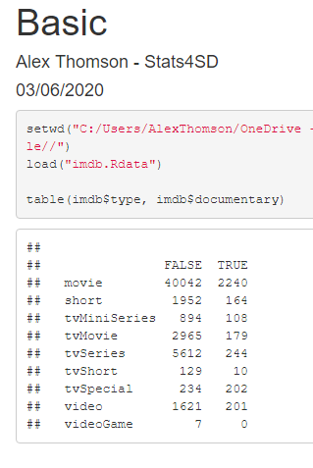
Rmarkdown
Additional feature within R that allows you to make or “knit” documents
Conduct analysis and write text within the same file without constantly switching between the two
Some have even used it to write whole reports and books (beyond what we need for now)

Slide 6
Packages
There are many packages available for exporting tables from R.
FlexTable
A package designed for exporting tables from markdown, though can also be used in normal scripts with tables exported as images.
Kable
A package which can export tables into multiple document types though works best with pdf or html. A more technical alternative
gt
A package still in development by the Rstudio team intended to be the “ggplot2” for tables

Slide 7

FlexTable
Flextable can work with html, Word, PowerPoint and pdf (requires an additional package) as well as export tables as images.
Quite flexible and fairly simple to understand how most functions work
Idea is to create a representation of a data.frame which can then be manipulated

Slide 8
FlexTable
General flow;
t <- flextable(dataframe, col_keys = ….)
t <- fontsize(t, part = …)
t <- add_header_lines(t, value = …)
t <- autofit(t)
t
Transform a data frame into a flextable object using the flextable function & col_keys.
Then can edit this object by changing fontsize, add headers and footers, change column names, change cell sizes
Always using left assign when adding in new changes

Slide 9
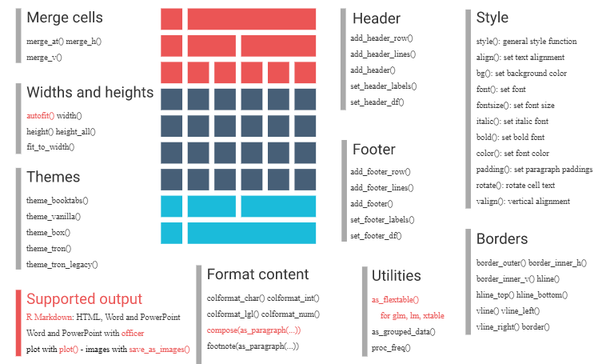
Wide array of functions

Slide 10
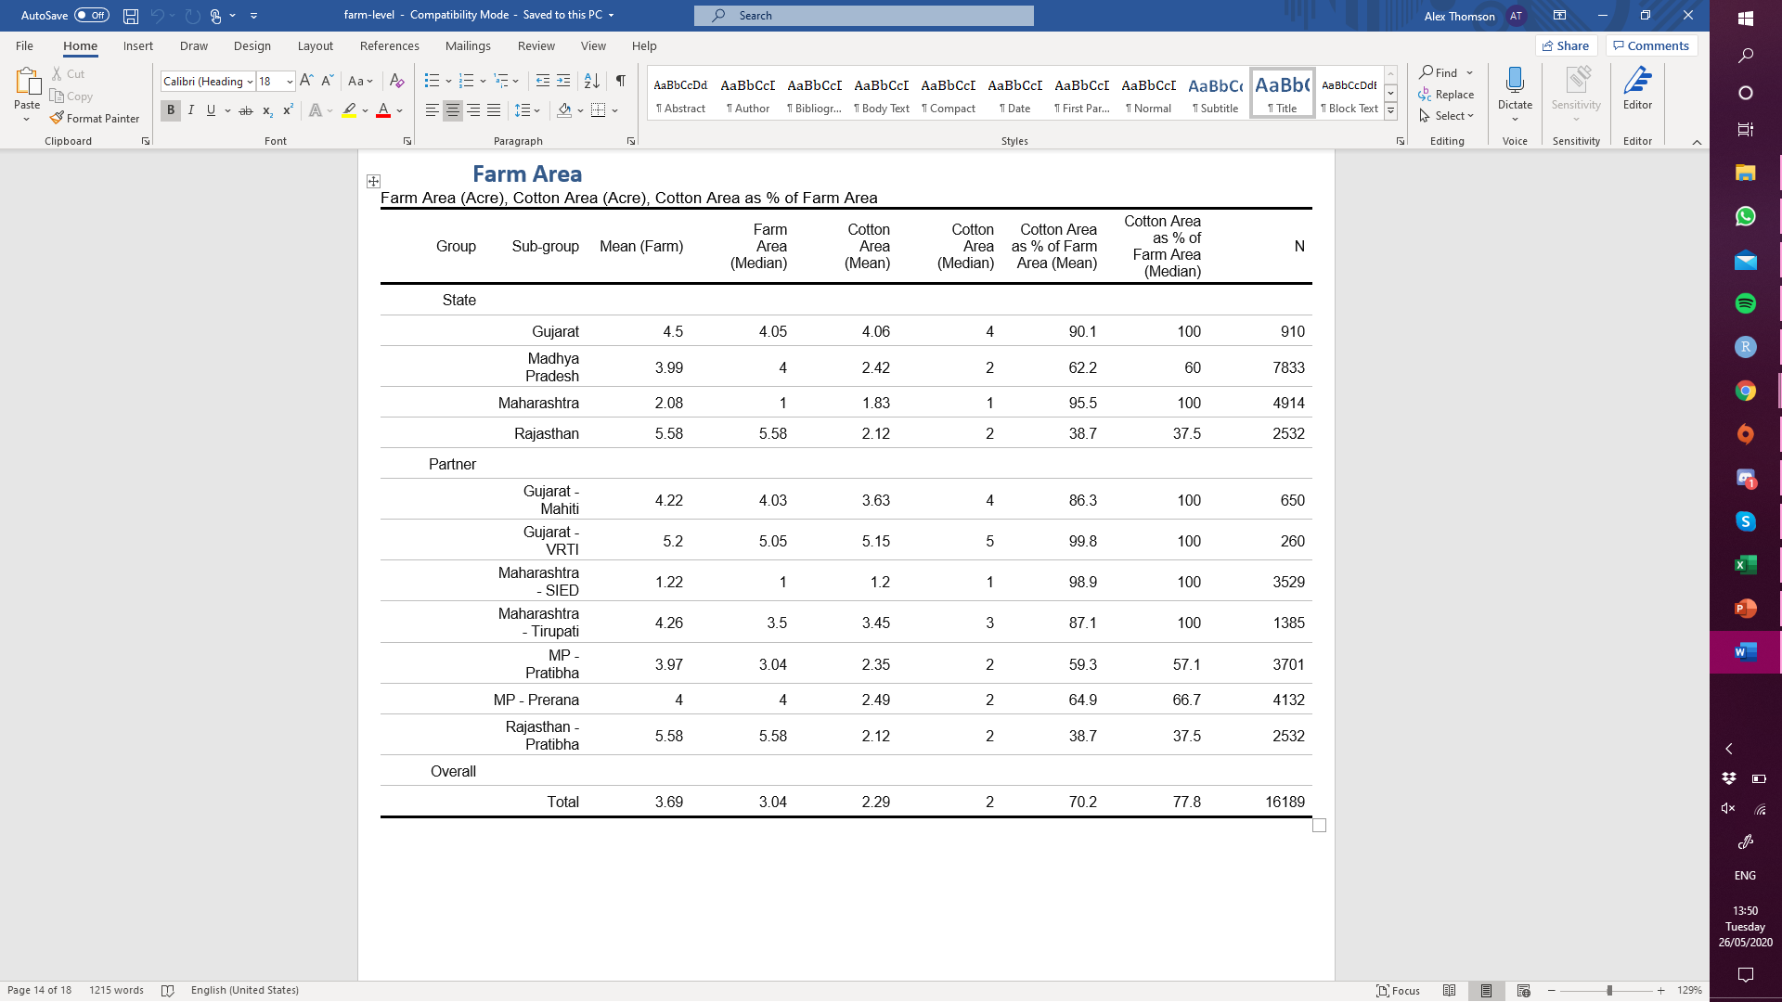
Same output regardless of format i.e html and word will look the same. (pdf requires and additional package but not too complicated)
A$Group <- c(rep("State", 4), rep("Partner", 7), "Overall")
A <- as_grouped_data(x = A,
groups = c("Group"), columns = NULL)
A[is.na(A)] = " “
border_h = officer::fp_border(color="gray")
t <- flextable(A)
t <- set_header_labels(t, values = list(Group = "Group",
`Sub-Group` = "Sub-group",
`Mean (Farm` = str_wrap("Farm Area (Mean)",7),
`Median (Farm)` = str_wrap("Farm Area (Median)",7),
`Mean (Cottton)` = str_wrap("Cotton Area (Mean)",7),
`Median (Cotton)` = str_wrap("Cotton Area (Median)",7),
`Mean (%Cotton)` = str_wrap("Cotton Area as % of Farm Area (Mean)",12),
`Median (%Cotton)` = str_wrap("Cotton Area as % of Farm Area (Median)",12),
N = "N"))
t < -fontsize(t, size = 9, part = "all")
t <- width(t, width = 0.90)
t <- add_header_lines(t, values = "Farm Area (Acre), Cotton Area (Acre), Cotton Area as % of Farm Area“)
t <- border_inner_h(t, part="body", border = border_h )
t

Slide 11

Kable/kableExtra
Kable is the more technical alternative with greater focus on building HTML tables
Can produce other formats
However some tweaks are needed depending on your format unlike with flextable
Similarly quite flexible with additional specs for HTML
Can get a very basic table in Word using just knitr::kable(data.frame) (Sam’s preferred option)

Slide 12
Kable/KableExtra
Knitr::kable(x, format (set format of table), some formatting arguments (names, align, etc.)%>%
kable_styling()%>% column_spec()%>%
row_spec()%>%
collapse_rows()%>%
footnote()%>%
General flow works in similar fashion to tidyverse and functions tend to be simple to remember
Difficulty comes largely from the issue with format of output (format = “latex”, “html”, “markdown”, “pandoc” and “rat”)
This changes what is and is not possible, word especially limited
KableExtra optimized for HTML

Slide 13
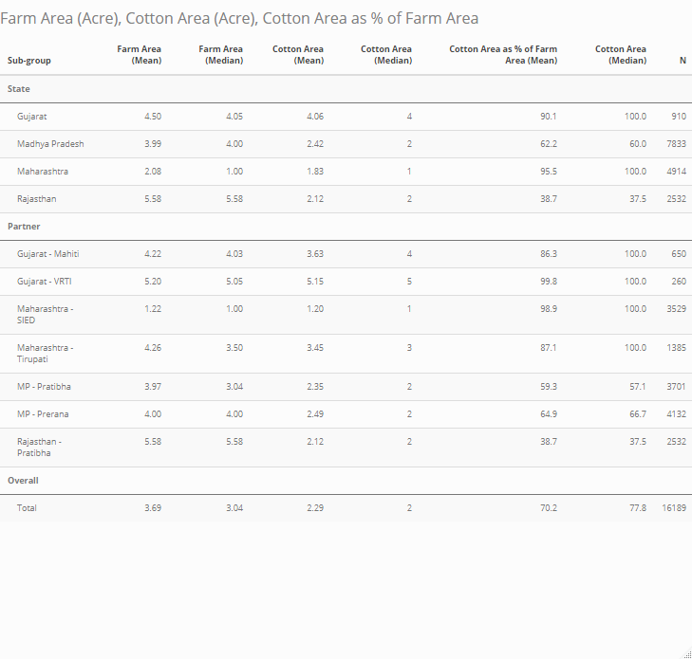
Optimized for html, requires no direct formatting of width (can be responsive), looks very tidy and all features are available
knitr::kable(A,
"html",
col.names = c("Sub-group",
"Farm Area (Mean)",
"Farm Area (Median)",
"Cotton Area (Mean)",
"Cotton Area (Median)",
"Cotton Area as % of Farm Area (Mean)",
"Cotton Area (Median)",
"N"),
caption = "Farm Area (Acre), Cotton Area (Acre), Cotton Area as % of Farm Area")%>%
kable_styling(font_size = 9,
bootstrap_options = c("striped"))%>%
pack_rows(group_label = "State", 1, 4)%>%
pack_rows(group_label = "Partner", 5, 11)%>%
pack_rows(group_label = "Overall",12, 12)

Slide 14
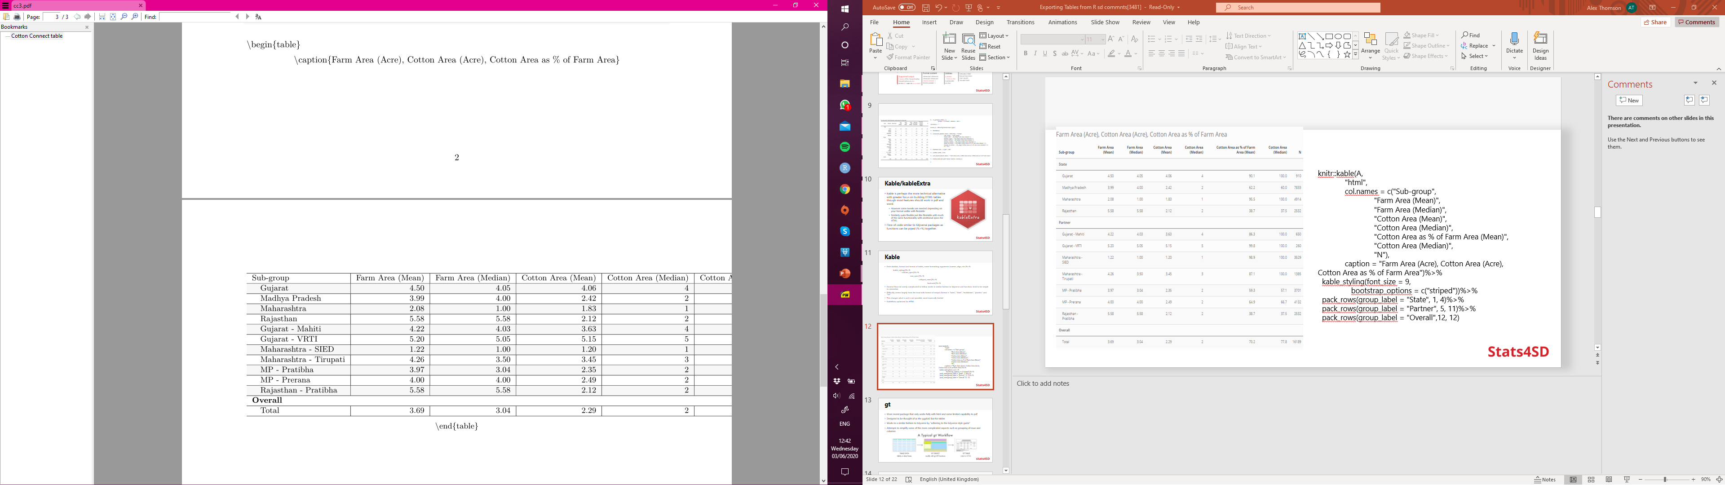
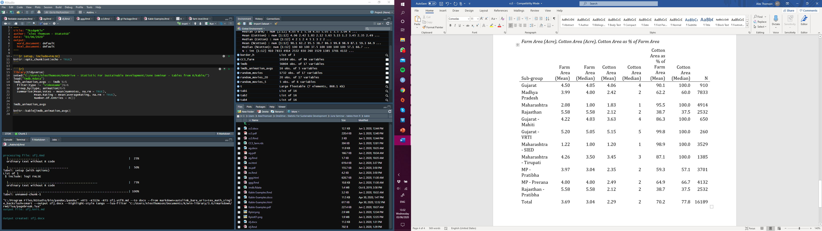
When trying pdf (LaTex), some features failed to work and width needs specifying
When trying word (pandoc), no formatting, no pack rows

Slide 15
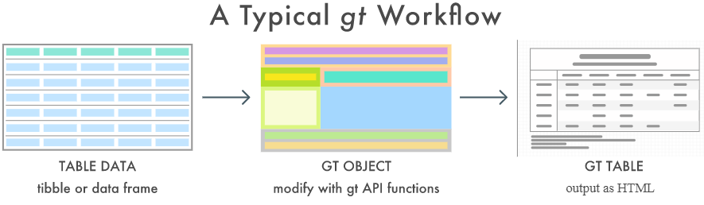
gt
More recent package that only works fully with html and some limited capability to pdf
Designed to be thought of as the ggplot2 but for tables
Works in a similar fashion to tidyverse by “adhering to the tidyverse style guide”
Attempts to simplify some of the more complicated aspects such as grouping of rows and columns

Slide 16
gt
As with other tidyverse packages one stumbling block is the language it creates including “stub” and “spanner”
Stub is the row labels and row group labels
Spanner is a group of columns
Similar flow to kable
gt(data.frame)%>%
tab_header(…)%>%
tab_row_group(…)%>%
tab_footnote(…)%>%...

Slide 17
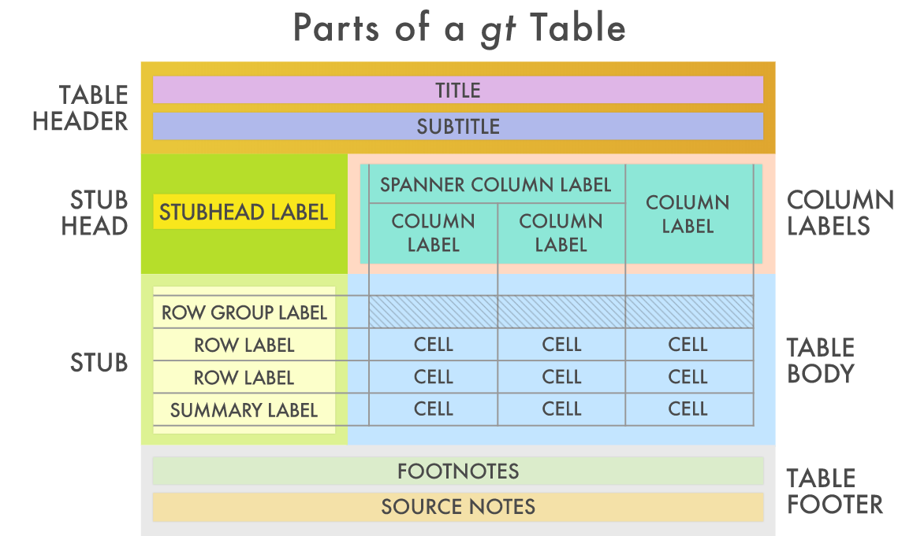

Slide 18
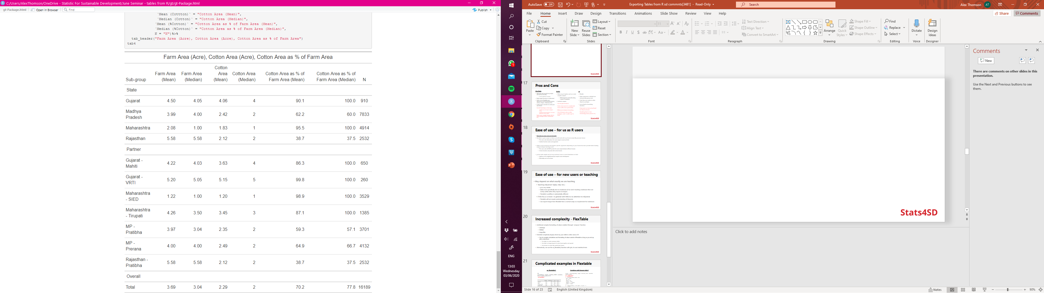
A$Group <- c(rep("State", 4), rep("Partner", 7), "Overall")
A <- select(A, Group, `Sub-group`:N)
tab4 <- gt(A, groupname_col = "Group")%>%
cols_label(`Sub-group` = "Sub-group",
`Mean (Farm)` = "Farm Area (Mean)",
`Median (Farm)` = "Farm Area (Median)",
`Mean (Cottton)` = "Cotton Area (Mean)",
`Median (Cotton)` = "Cotton Area (Median)",
`Mean (%Cotton)` = "Cotton Area as % of Farm Area (Mean)",
`Median (%Cotton)` = "Cotton Area as % of Farm Area (Median)",
N = "N")%>%
tab_header("Farm Area (Acre), Cotton Area (Acre), Cotton Area as % of Farm Area“)
tab4

Slide 19
Pros and Cons
FlexTable
Will work with basically any output with full functionality
Can be exported as images
Fairly simple functions to understand
Quite a lot of flexibility over appearances and formatting (borders, colours, images, collapsing rows)
Could create a function to create your own theme
Can be frustrating in a few ways
Autofit does not respect wrapped strings
Ordering of your functions can make a difference to the output
Some more complex features rely on other packages (officer, officedown etc.)

Slide 20
Pros and Cons
Kable
Wide array of options and can create complex outputs
Well designed to work with writing a report in markdown
Aesthetic outputs
Probably the preferred option for html (think tables in Shiny apps)
Can be quite technical
Differences between formatting
Lots of features rely on other packages, some I couldn’t get to work
Not advisable for nice/complicated tables in word unless you export as an image

Slide 21
Pros and Cons
gt
Flexible
Quite responsive as default (can automatically group rows)
Code flow very similar to other tidyverse packages
Lots of built in formatting functions
Only works for html and pdf (pdf not fully functional)
Limited documentation (still new)
Stumbling block of new terminology (stub, spanner etc.)

Slide 22
Ease of use – for us as R users
Depends on your areas of strength
FlexTable is quite simple to follow and will work with any format easily (My personal choice)
The same code will produce the same output in word and html
Intuitive function names and arguments
Kable is more technical and requires specific arguments depending on your format
but does provide better looking outputs
The same code will NOT provide the same output between different formats
Certain functions only work with certain formats
gt also quite simple and not very technical, issue is current limitations to html
Appears to be straightforward just requires more development
Potentially one for the future

Slide 23
Ease of use – for new users or teaching
May depend on what exactly we are teaching
Teaching tidyverse? (dplyr, tidyr etc.)
gt is very similar
kable more specifically tied to rmarkdown
Flextable’s workflow is substantially different
If the focus is more r in general with little to no attention to tidyverse
Flextable will not require understanding of tidyverse
Can export images from flextable from a normal script, no requirement for markdown

Slide 24
Increased complexity - FlexTable
Additional complex formatting of values enabled through `compose` function
Linerange
Minibar
Image files
Potential complexity largely driven by your skills in other areas of R
Can do complex calculations and formatting of values outside of flextable so long as you end up with a data.frame/tibble
Use dplyr to create summary tables
Use tidyr to change layout of a data frame (gather and spread)
Use broom to create tidy model data frames
Alternatively, can use the as_flextable() function with glm, lm and statistical tests

Slide 25
Quick word on Broom
Broom could be a useful intermediate step if you are wanting to create nice looking tables for models or t tests
Another package designed to be akin to other tidyverse packages
Used to create “tidy” data frames from model objects
tidy() – construct a data frame summarizing the model (coefficients, p-values etc.)
augment() – add columns including predictions and residuals
glance() – create a one row summary of the model (R-squared, AIC, BIC etc.)
As the output is a single data frame, can then use one of these packages to create a nice model summary table.

Slide 26
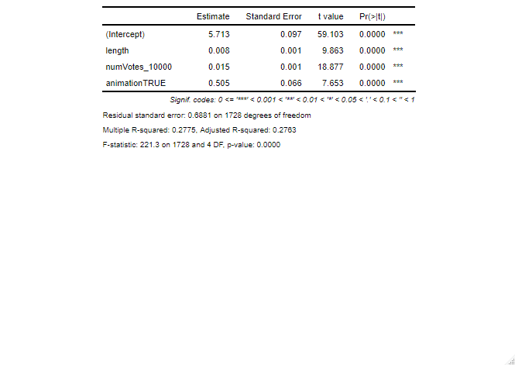
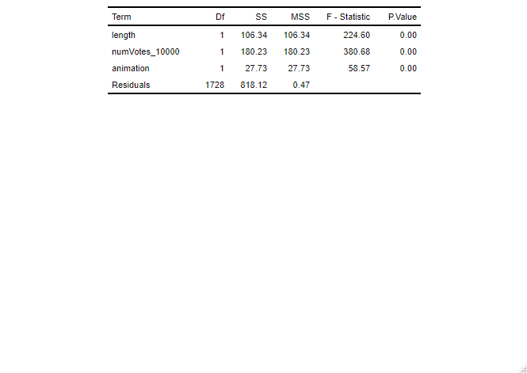
Complicated examples in Flextable
as_flextable()
lm(
averageRating ~ length + numVotes_10000 + animation,
data = random_movies) %>%
as_flextable()
Combine with broom::tidy()
model1 <- aov(averageRating ~ length + numVotes_10000 + animation, random_movies)
m1 <- tidy(model1)
t <- flextable(m1)
t <- colformat_num(t, j = c(3:6), digits = 2, na_str = " ")
t <- autofit(t)
t
# add some footnotes for test results etc. (t <- footnote(…))

Slide 27
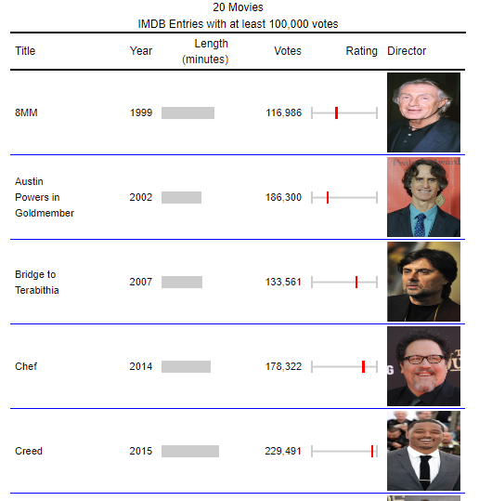
Special Features - Flextable
Input image files into the table
Greater control over borders, think what you can do directly in word
Minibars within the table as data visualization
Use line ranges as data visualization

Slide 28
Increased complexity - Kable
The functions you can use to group rows/columns, change colours etc. are not overly complicated once you are familiar with the basics
Some complexity is dependent on skills with other packages
Tidy model tables could be done with broom
The most complicated features of Kable relate to specifically converting to certain formats
Those experienced with html/LaTex can definitely make something more complex
Scroll bars
Responsive to screen size
Can be quite responsive to shiny

Slide 29
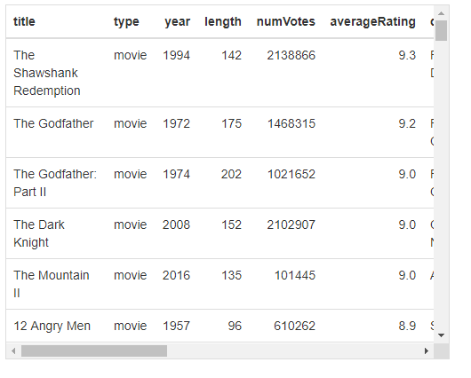
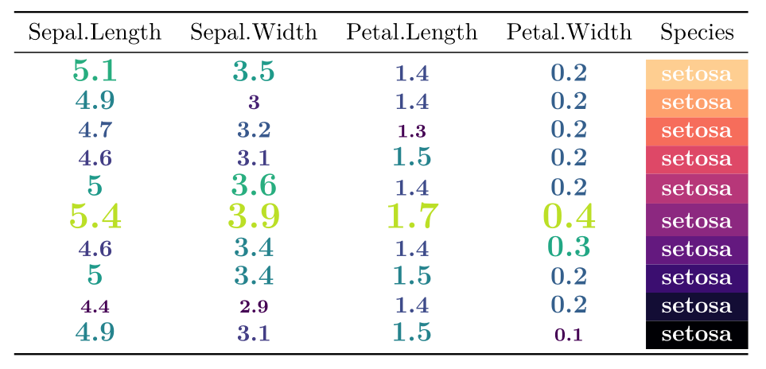
Special Features - kableExtra
Dynamically colour text, cell backgrounds and text size
HTML Scroll boxes

Slide 30
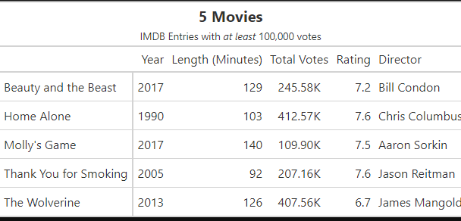
Special Features - gt
Special features of gt largely tied to formatting of values
Flextable and kable formatting mostly focused on text and numbers
e.g. Suffixing of large numbers
fmt_number() | Format numeric values
fmt_scientific() | Format values to scientific notation
fmt_percent() | Format values as a percentage
fmt_currency() | Format values as currencies
fmt_date() | Format values as dates
fmt_time() | Format values as times
fmt_datetime() | Format values as date-times

Slide 31
Which package should you use
Best to choose which package suits your needs and skills
Fletxtable
All purpose
Very useful when using word
Kable
Best suited for those wanting to work in html of pdf
Especially useful for shiny
Gt
Good for those used to tidyverse packages

Slide 32
Links
Flextable
https://davidgohel.github.io/flextable/articles/overview.html
gt
https://gt.rstudio.com/
Kable/kableExtra
https://cran.r-project.org/web/packages/kableExtra/vignettes/awesome_table_in_html.html

